Slide 1





15.2 Double Integrals over General Regions
Example 1：
Find the volume of the solid under the surface
over the region D on the xoy plane.
Step 1. We begin by covering R with a grid of
small cells whose union contains
all points of R： ，with
these cells as bases, we can partion the solid into n small
solids .

Slide 2
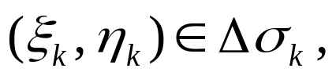

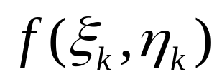

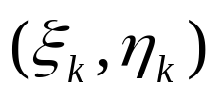

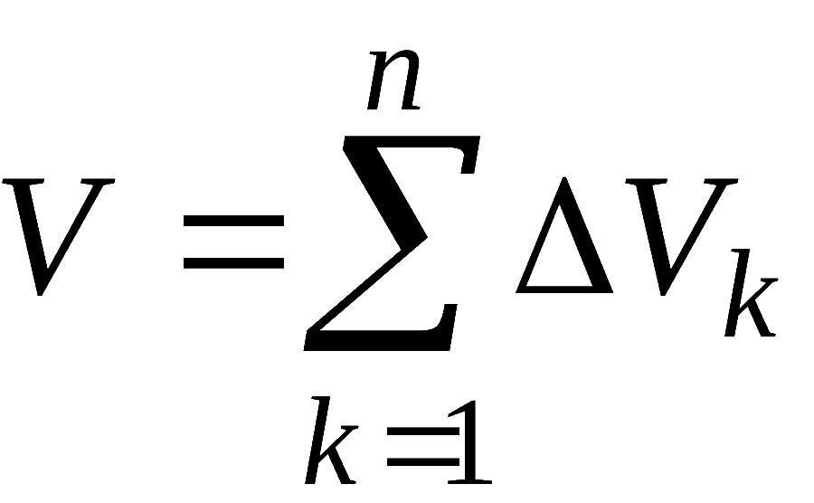
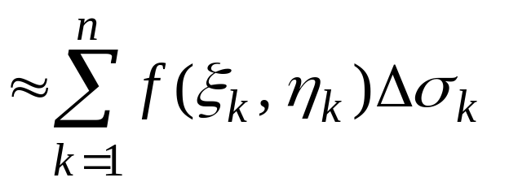
Step 2. For the k-th small solid, we first take an any point and then constrct a cylinder with base and height
we use the volume of cylinder to approximate the volume of small solid:
Step 3. Aproximate the volume

Slide 3
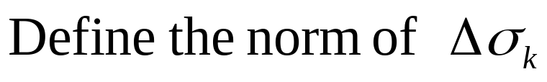
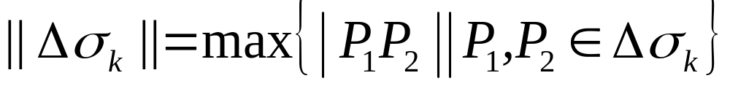
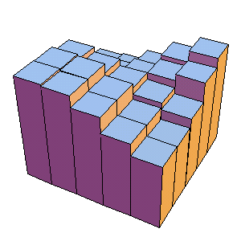
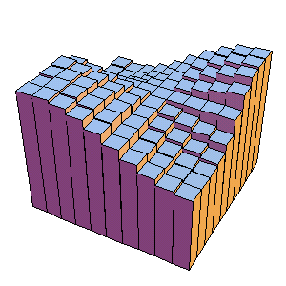
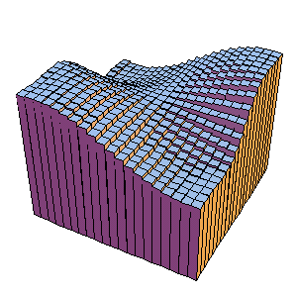
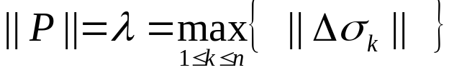
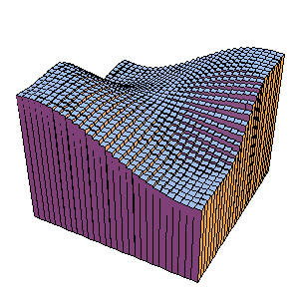
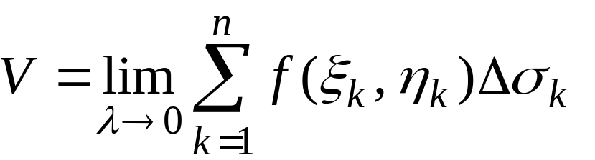
Step 4. Taking limit:
Let

Slide 4




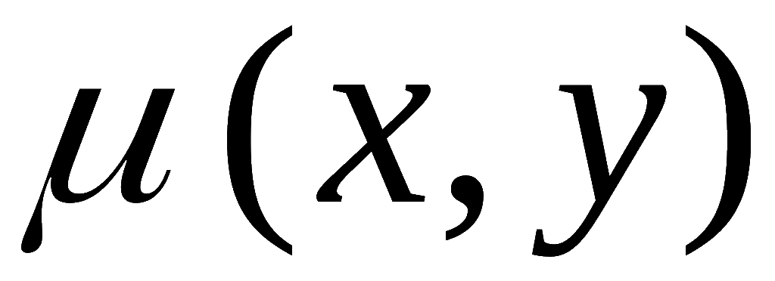



Example 2. Find the mass of a thin sheet
There is a thin sheet D on the xoy plane, the surface density
is
find its mass M .
the area of D is σ ,
then
(2) If
is not constant ,
Step 1.
Partion D into n small region by a grid of cells

Slide 5
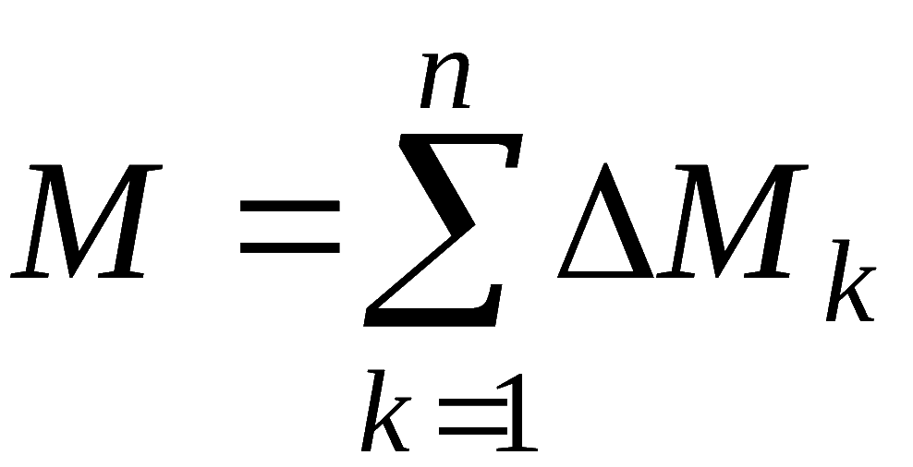
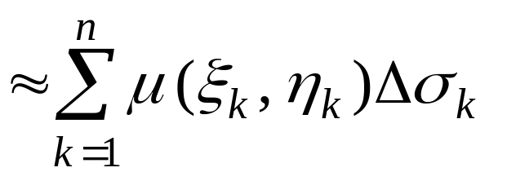


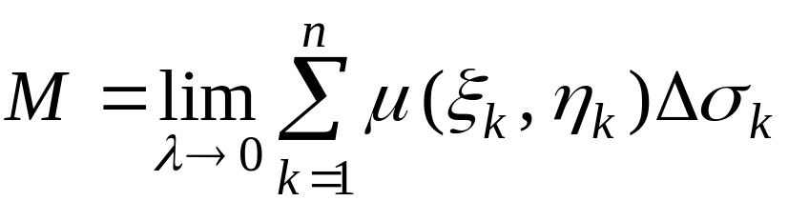
Step 2. we first take an any point
then the mass of k-th small sheet can be approximated by
Step 3. Aproximate the totall mass
Step 4. Taking limit:
Let

Slide 6
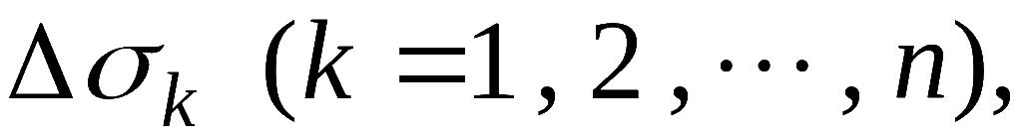
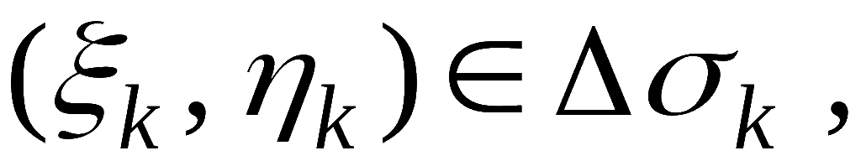
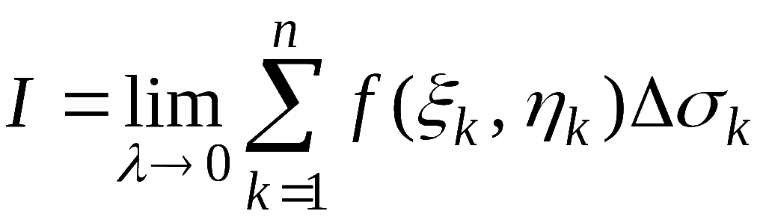
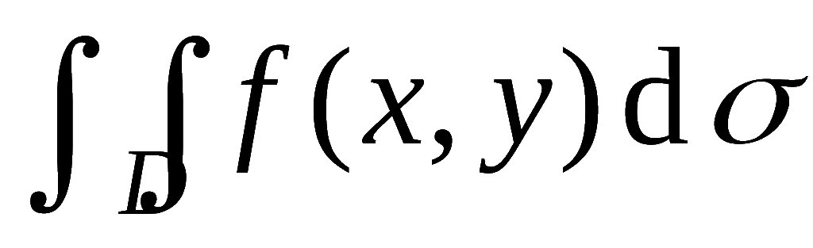
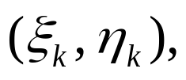
Definition: f (x,y) is bounded on a bounded region D, we partion D into n small region
take any point
If there exists a number I such that
denote
no matter the partition and the choices of then we call f (x,y) is integrable, and I is called the double integral of f(x,y) over D).

Slide 7
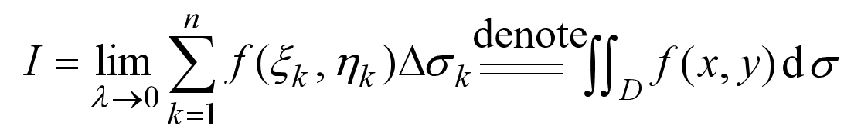
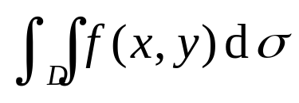
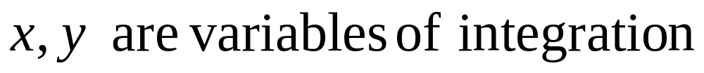
Riemann Sum
region fo integral
area element
integrand

Slide 8

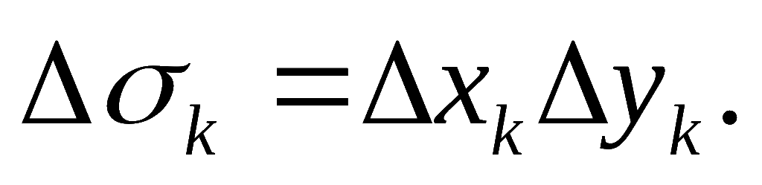
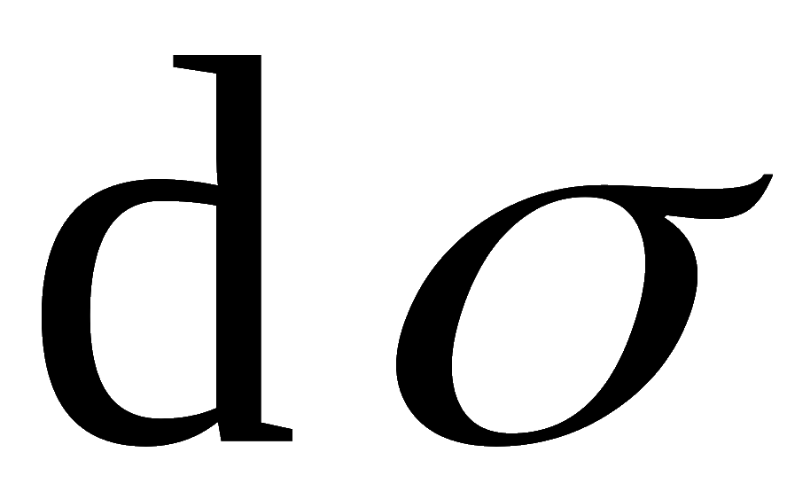

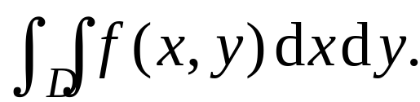
If is integrable on D, then we can partition D by horiontal and vertical lines, then most cells are retangles, and the area is Since as the norm of the partition approaches 0, the area of remaining cells approach 0.
For this reason, the area element
is often
denoted by
and the double integral is written as

Slide 9


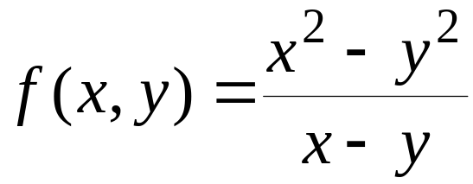


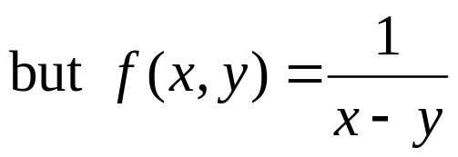


Ingegrability: (Existence of double integrals)
Theorem 1.
If
is continuous on the closed bounded
region D , then
is integrable on D.
Theorem 2.
If the bounded function
is continuous
on D except finite points and finite curvrs , then is
integrable on D.
Example,
is integrable on
D :
is not
integrable on D .

Slide 10
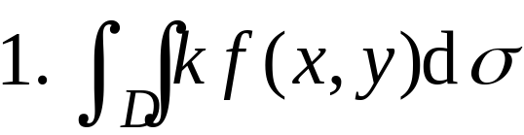
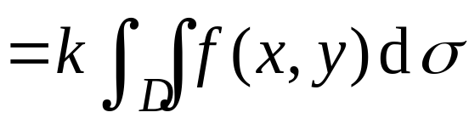
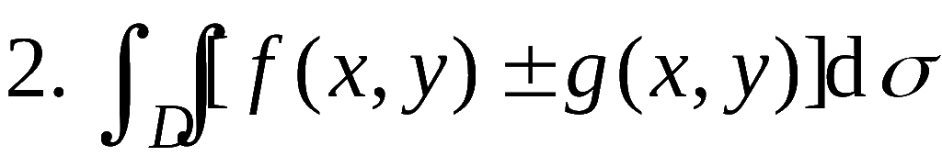
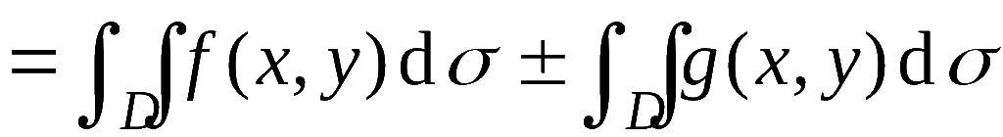
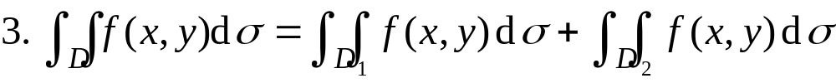
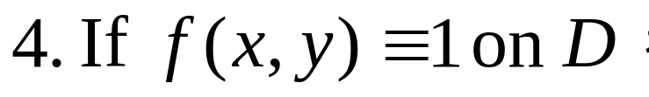
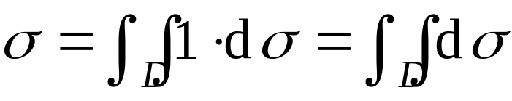
Properties of double integrals
( k is a constant)
σ is the area of D , then

Slide 11
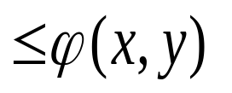
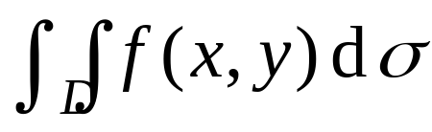
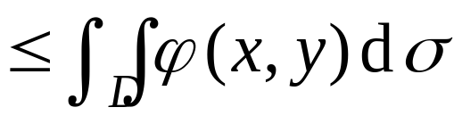

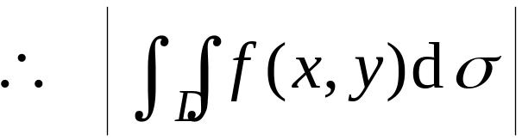
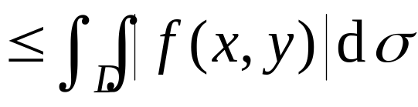
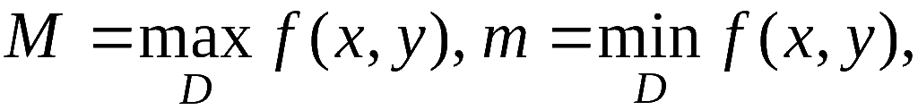
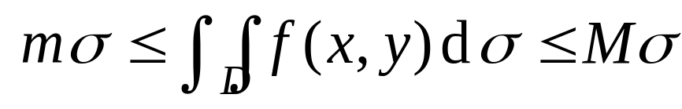
5. If on D, then
In particular, since
6. If
the area of D is σ ,
then

Slide 12
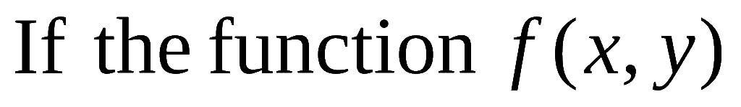

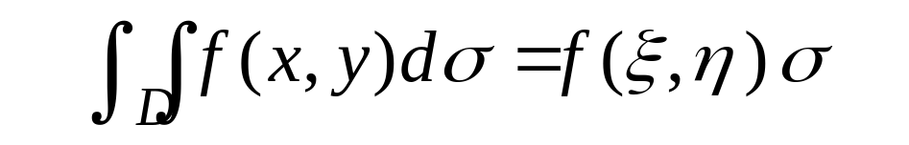
7.(Mean value theorem of double integral )
is continuous on the closed
region D,
σ is the area of D ,
then there exists at least a
such that

Slide 13
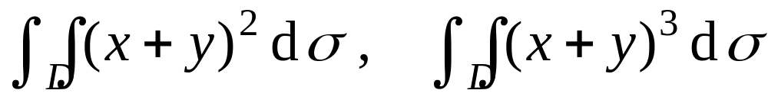
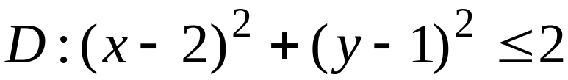



Example 1: Rank the double integrals
where

Slide 14
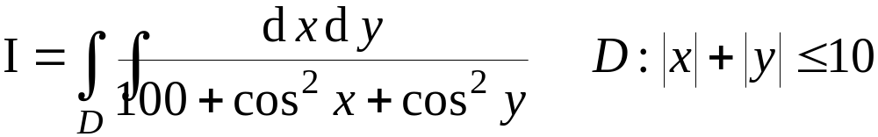





Example 2. Estimate the following double integral
D

Slide 15


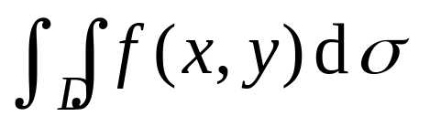







Example 3. If is continuous on the closed
region D,
the region D is symmetric about x axis
D₁ is the region above x axis,
if on D,
then
then
then

Slide 16





Example 4: Rank the double integrals

Slide 17






Example 5: D is a closed bounded region in the
second quadrant where 0 < y <1, and
the correct relation is ( )

